Slide 1

The Decline of the Middle Class: How and Why it Happened and What to do About it.

Slide 2
This lecture and discussion will explore the fundamental shifts that occurred in America that transformed the U.S. economy from Stakeholder Capitalism benefitting all to one driven by a philosophy of maximizing shareholder value that created extreme inequality and a hollowing of the nation's Middle Class. It will explore implications for the current election and future policy directions.

Slide 3
The Transformation
There has been a fundamental transformation of the American economy from one where workers were valued and shared fairly in a growing economy gaining access to the middle class to one where most corporations shifted to a philosophy that “maximizes shareholder value” at the expense of workers.

Slide 4
A New Political Strategy
Compounding the problem, at the same time corporations adopted a new a new partisan political strategy when they aligned with the increasingly right wing of the Republican Party.

Slide 5
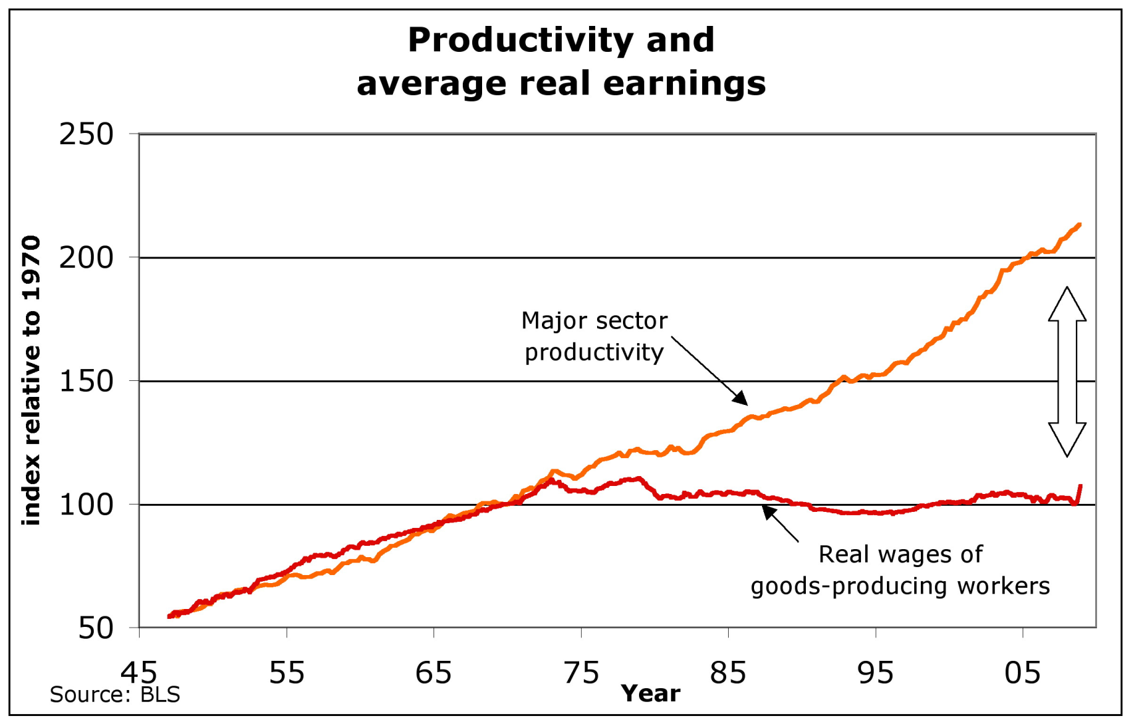
The Gap

Slide 6
“The Great Compression”
End of WWII to 1974
“Virtuous cycle of growth”
“Stakeholder capitalism”
“Mixed economy”
A period of unprecedented prosperity: high wages paid to middle-class Americans, job security, family supporting benefits such as health care and pensions and generous profits for business.

Slide 7
Frank Adams, CEO of Standard Oil
The job of management is to maintain an equitable and working balance among the claims of the various directly affected interest groups…stockholders, employees, customers, and the public at large.

Slide 8
George Romney
Prosperity gained through bargaining and compromise among stakeholders
“Rugged individualism is nothing but a political banner to cover up greed.”
Raise minimum wage; increased education spending; supported unemployed and poor
Collective bargaining for teachers

Slide 9
President Eisenhower
“Should any political party attempt to abolish social security, unemployment insurance, and eliminate labor laws and farm programs, you would not hear from that party again in our political history.”
“(Right-to-Work laws) are a virtual conspiracy of the crafty, the ignorant, or the misguided to subvert industrial peace, exploit men’s need to work and deluge the community with industrial irresponsibility”

Slide 10
“The New Economy”
The doctrine is that the sole corporate mission is to reverse the “virtuous circle” and “stakeholder capitalism” philosophy - the one that helped create broad prosperity and a growing middle class following World War II and replace it with “Stakeholder Capitalism.”

Slide 11
Capitalism and Freedom by
Milton Friedman
“Few trends could so thoroughly undermine the very foundations of our free society as the acceptance by corporate officials of a social responsibility other than to make as much money for their stockholders as possible.”
Gone was the idea that the destinies of labor and management should be linked and they should share roughly equally in economic and productivity gains.

Slide 12
The Shareholder Value Myth by
Lynn Stout
For most of the 20th century, managers believed public corporations should serve not only their shareholders, but also employees, customers, the nation and future generations. American companies pursued long-term research that would not produce profits for years or even decades.

Slide 13
Stout…
Shareholders “own” corporations
Executive pay tied to shareholder returns
Buy shares, pump up price, sell for quick profit
Boost share price by any means possible
Shareholder value is “king.”
Goal: Maximize shareholder value by an exclusive focus on short-term profits

Slide 14
The Powell Manifesto
A memorandum for the U.S. Chamber of Commerce calling for a corporate takeover of America’s dominant public institutions to advance this transformation agenda through political power.
Political power must be “assiduously cultivated.”
Political power “must be used aggressively and with determination” by corporations.

Slide 15
“Revolt of the Bosses”
Embraced by a new class of conservative family and corporate foundations such as those supported by the Koch brothers, Coors, Wal-Mart, Scaife and others.
Heritage Foundation, American Enterprise Institute, Americans for Tax Reform, Hoover Institution, Manhattan Institute for Policy Studies, Mackinac Center for Policy Studies and Cato Institute among others.

Slide 16
The Result
The evidence clearly demonstrates that the current state of working Americans is primarily driven by the fundamental shift toward maximizing profits and shareholder value as opposed to maintaining “an equitable and working balance among the claims of the various directly affected interest groups: stockholders, employees, customers, and the public at large.”

Slide 17
Stephen Roach
(Morgan Stanley)
If I were to describe the new role of the ‘90s, it would really probably start and finish with the power of the financial markets…to really control the destiny, the strategy of the corporation. Shareholders got rewarded beyond their wildest dreams, but there’s a cost – through stagnant wages, through downsizing and layoffs, through widening inequalities. Capital wins but at a cost…The 1990s is the ultimate triumph of shareholders around the world, the worker is pretty much a pawn in the process.

Slide 18
A New Partnership
To advance “The New Economy,” a new synergy developed between a growing conservative Republican Party and the leaders of the “shareholder value” business leaders and the economists who advanced their ideology.

Slide 19
The Strategy
Congressman Tom DeLay and his K Street Project pushed a strategy that GOP leaders would only be responsive to “their friends.”
Abandoning an earlier strategy to work with both Democrats and Republicans, the business community was pressured to adopt Republican positions and hire only Republican personnel, “pay to play.”
The business community played ball.

Slide 20
The Koch Brothers
Americans for Prosperity (AFP) helped lead the attack on collective bargaining rights for public employees, supported passage of “right-to-work” laws, opposes climate change legislation, raising the minimum wage, opposition to Obamacare and supported the Supreme Court Citizens United case that prohibited the government from restricting independent political expenditures by a nonprofit corporation.

Slide 21
The Consequences
Productivity
Wages & benefits
Health Insurance
Pensions
Minimum Wage
Income In equality
CEO Compensation
Worker Power

Slide 22
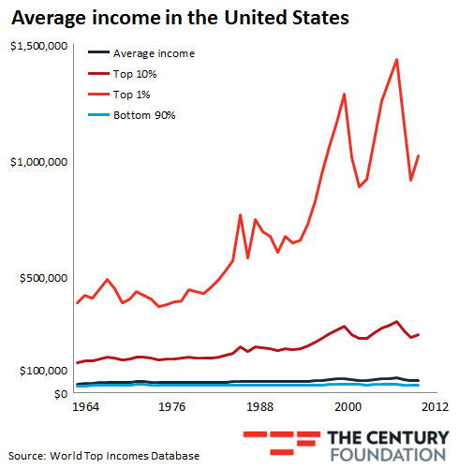
The Income Gap

Slide 23
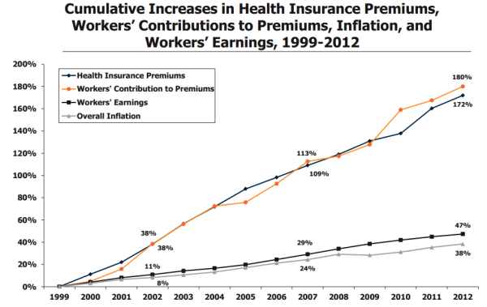
Health Insurance Costs

Slide 24
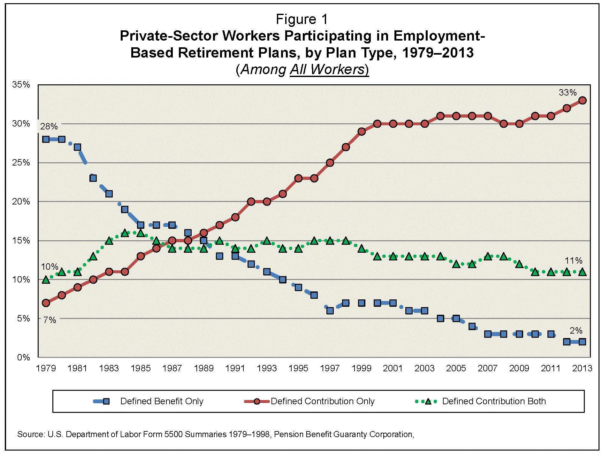
Retirement Plans

Slide 25
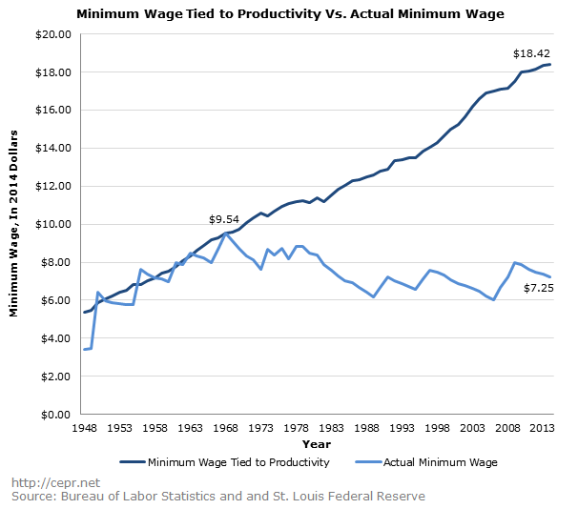
Minimum Wage

Slide 26
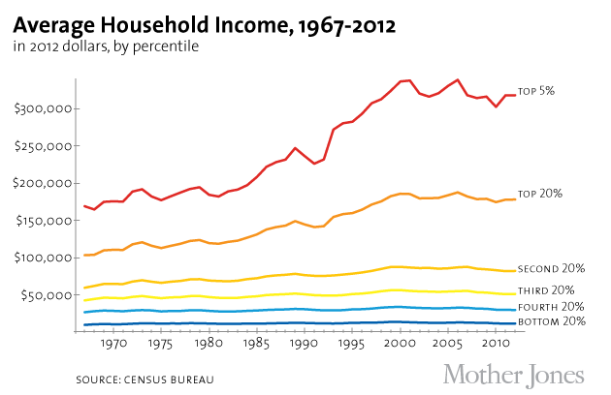
Average Household Income

Slide 27
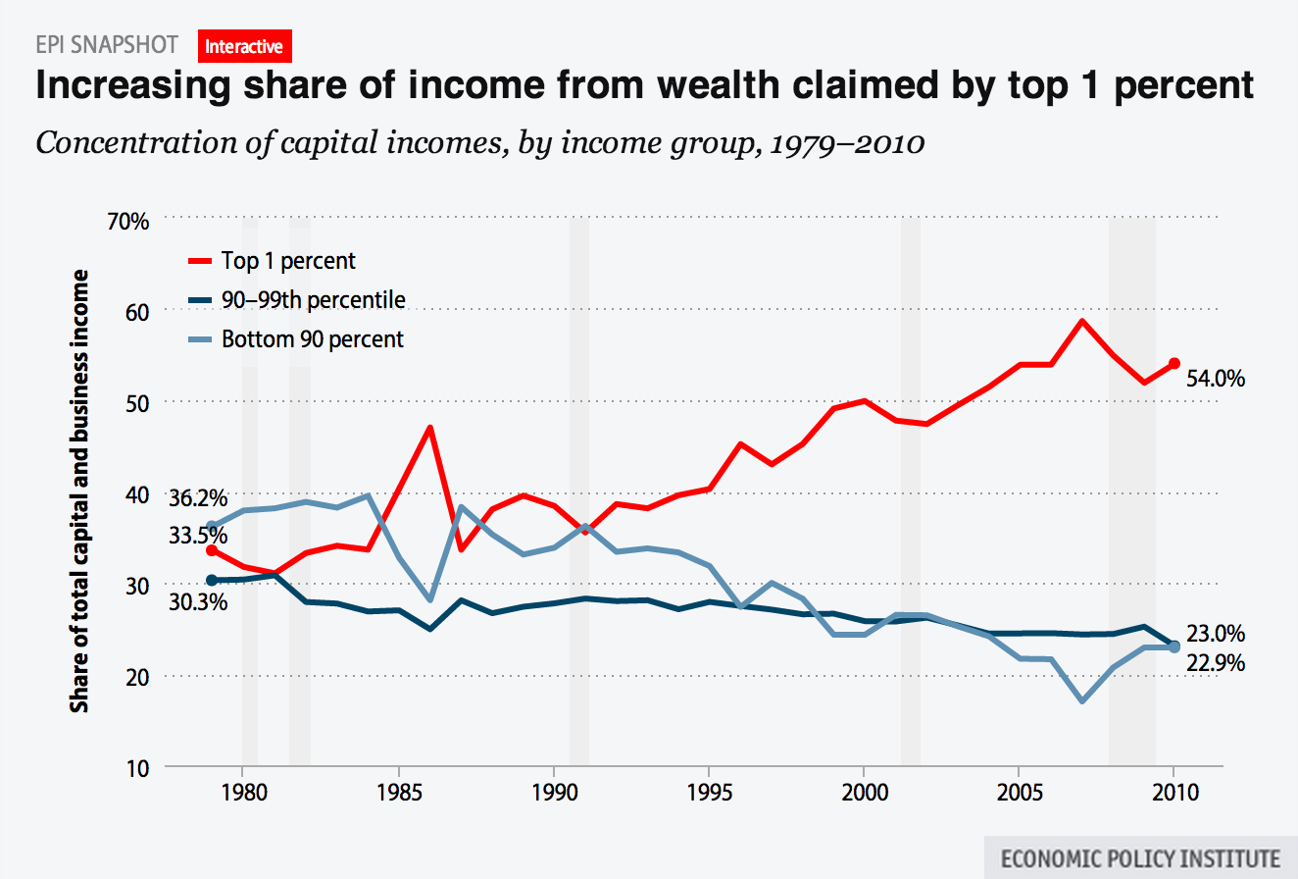
Top 1 Percent

Slide 28
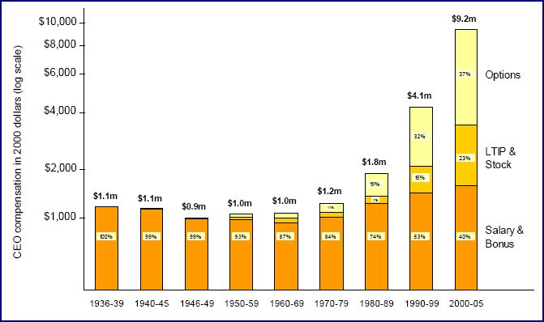
CEO Compensation

Slide 29
Growth of Labor
The right to organize and bargain collectively by the 1935 National Labor Relations Act (Wagner Act).
A major factor in raising wages and benefits of all workers and creating the largest middle class in the world.
It was a major factor in raising wages and benefits of all workers and creating the largest middle class in the world.
A counterweight to corporate power

Slide 30
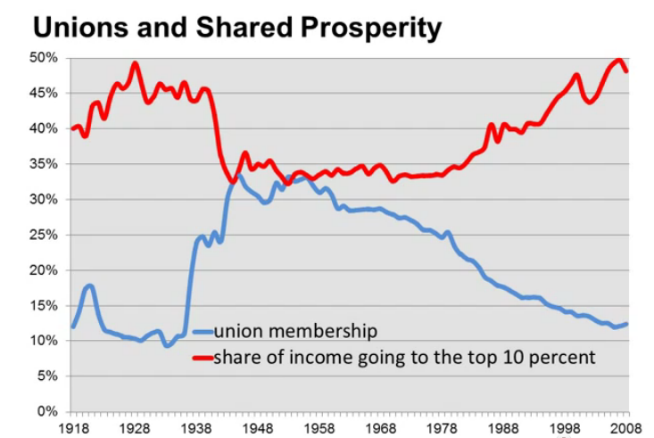
Union Impact

Slide 31
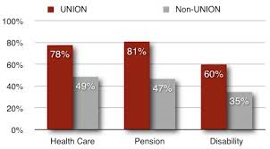

Slide 32
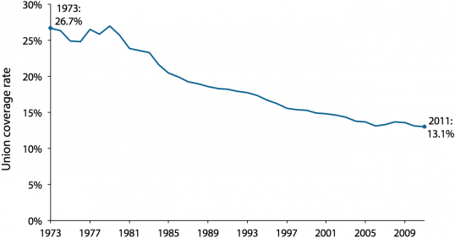
Union Membership

Slide 33
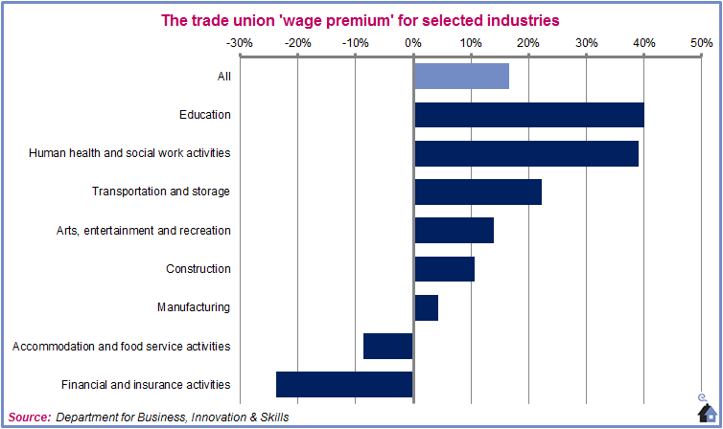
Union Wage Premium

Slide 34
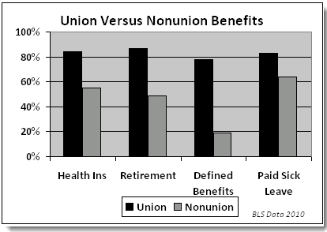
Union Benefits

Slide 35
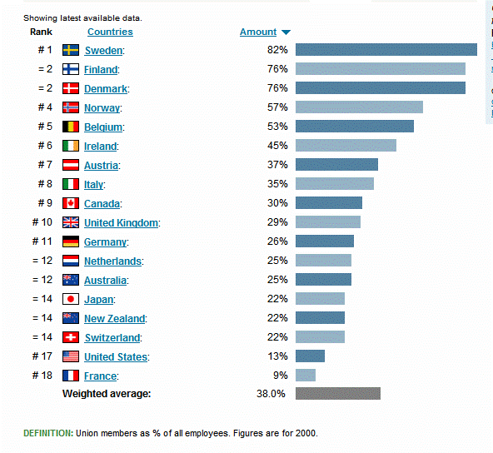
Union Membership by Country

Slide 36
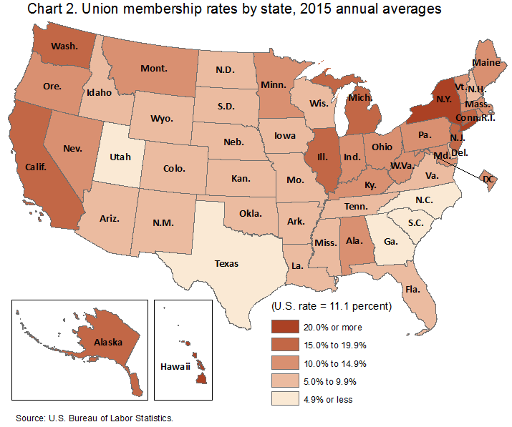
U.S. Union Membership

Slide 37
The Attack on Labor
The exclusive focus on “shareholder value” led to a strategy to weaken unions.
Ever since Ronald Reagan broke the air traffic controllers union in 1981, many corporations and their right-wing allies have carried out a vicious, no-holds-barred, ongoing war against organized labor.

Slide 38
Kate Bronfenbenner
No Holds barred – The Intensification of Employer Opposition to Organizing
- Captive audience meetings
- One-on one-meetings
- Anti-union committees
- Threatening to close
- Illegal discharges

Slide 39
Public Sector Attack
Focus on “Battleground States.”
Undermine wages, working conditions, legal protections, bargaining power, political power.
Focus on “right-to-work” laws
The Friedrichs case

Slide 40
The Real Motive
This battle is about eliminating unions so that the money is not there for the labor movement.
Scott Fitzgerald, Wisconsin Senate Leader
We fight these battles on taxes and regulations but really what we would like to see is to take the unions out at the knees so they don’t have the resources to fight these battles.
Michigan AFP Director

Slide 41
Whose Expense?
This is a well-orchestrated and implemented strategy of American business, conservative foundations and their backers, and a significant portion of the modern Republican Party to fundamentally alter the US economic and political landscape to reward capital at the expense of labor resulting in ever increasing income and wealth inequality.

Slide 42
The Obama Record
75 months of economic expansion, better than the recovery under Ronald Reagan.
The longest period of private sector job creation in American history.
Since the Great Recession ended, twelve million new jobs have been created.
The stock market continues to set new highs reaching 1800.
At least 18 million more Americans now have health insurance than before.

Slide 43
International Comparisons
Germany, as well as most Western European democracies, embraces the concept of “social partners,” meaning that they see business, labor and government as “partners” in efforts to build an economy that works for their country and all of its stakeholders, including workers.

Slide 44
Germany
German unions represent nearly three times the percentage of workers than is found in the U.S.
Codetermination: workers have an equal number of representatives on corporate boards.
German industrial workers’ wages and benefits are about one-third higher than in the U.S.
Germany runs a trade surplus only second to China

Slide 45
Key to Germany’s Success
The social contract is the willingness of business, labor, and political leaders to put aside some of their differences and make agreements in the national interest.
Alcoa CEO Klaus Kleinfield

Slide 46
Rewriting the Rules of the American Economy
Inequality in not inevitable: it is a choice we make with the rules we create to structure our economy. Over the last 35 years, America’s policy choices have been grounded in false assumptions, and the result is a weakened economy in which most Americans struggle to achieve or maintain a middle-class lifestyle while a small percentage enjoy an increasingly large share of the nation’s wealth.
Center for American Progress

Slide 47
Our Choice
We must make our choice.
We may have democracy, or we may have wealth concentrated in the hands of a few, but we cannot have both.
Supreme Court Justice Louis Brandeis

Slide 48
Paul F. Cole is executive director of the American Labor Studies Center and secretary-treasurer emeritus of the New York State
AFL-CIO.

